Slide 1
Image Partitioning for Compact Encoding
Group - 4
Hetvi Shah(AU2340101) Twisha Patel(AU2340056)
Manushree Patel(AU2340014) Sanya Shah(AU2340259)

Slide 2
INTRODUCTION
This project focuses on image partitioning and compression using the Region of Interest (ROI) concept. The image is divided into important and less important regions, for example, in medical images, the area containing the organ or disease is prioritized over the background to achieve efficient compression without losing critical details.

Slide 3
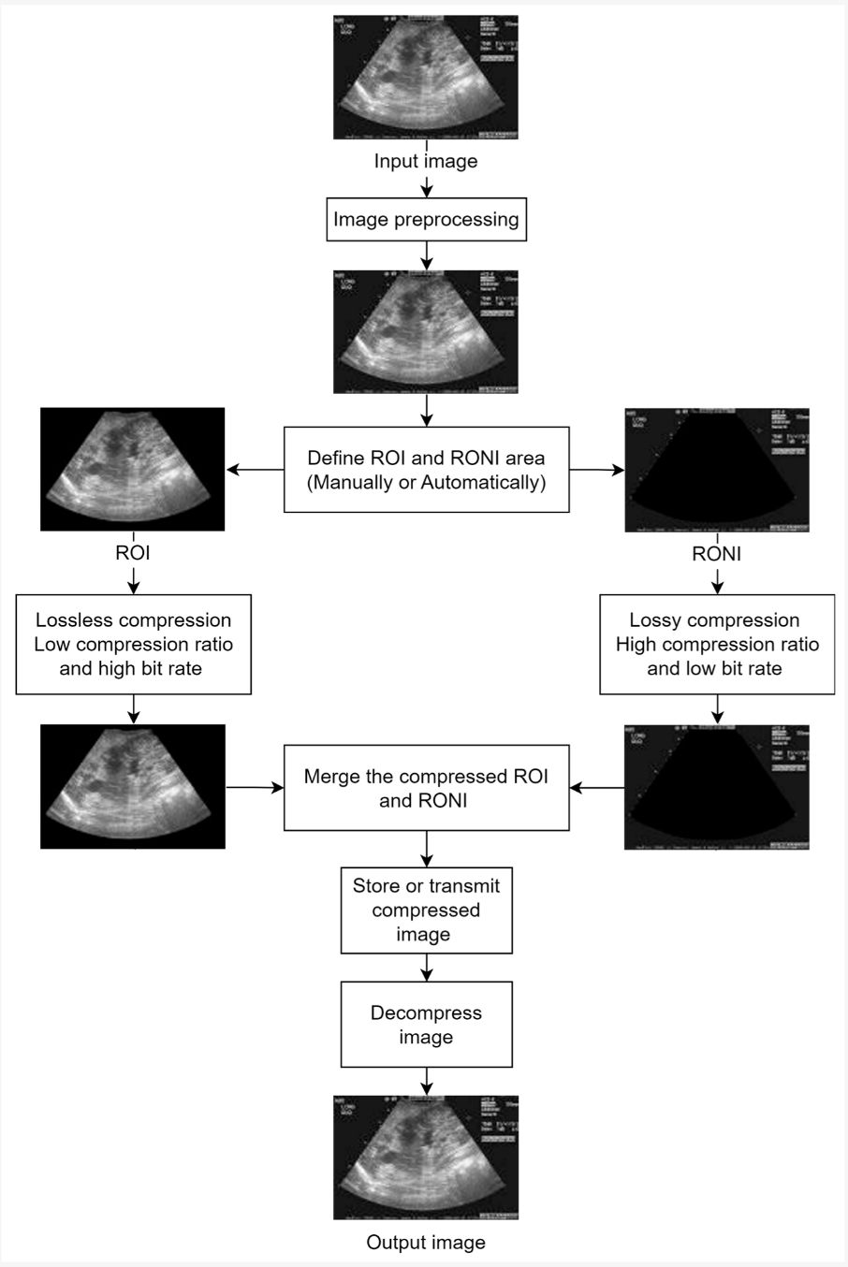

Slide 4
LITERATURE REVIEW
Method | Domain/Technique | Strengths | Limitations/Gaps
JPEG/JPEG-LS | Spatial, predictive & entropy coding | Simple, lossless compression | Treats all regions equally; ROI not prioritized
Block-based PCA | Statistical feature reduction | Reduces redundancy in local blocks | Ignores spatial–frequency variations; ROI edges blurred
JPEG 2000 (Wavelet ROI Coding) | Wavelet transform with Maxshift ROI | Multiresolution, better ROI preservation | Mixed blocks cause ROI boundary distortion
Proposed Method (Rectangular Partition + Wavelet/ Inverse Wavelet) | Hybrid spatial–frequency approach | ROI enhanced, Non-ROI blurred; mixed regions refined | More computation, but highest diagnostic fidelity

Slide 5
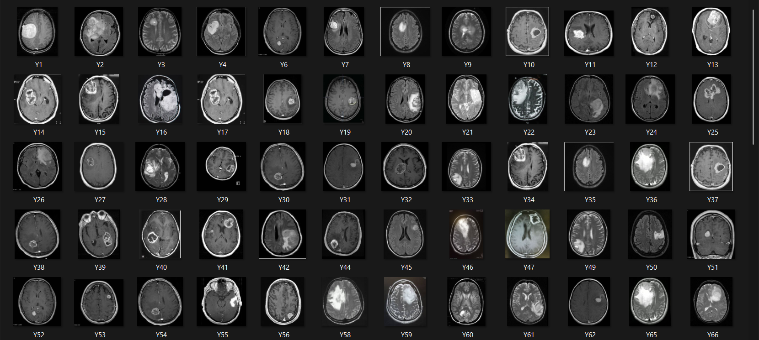
DATASET
It consist of images of brain with tumor.

Slide 6
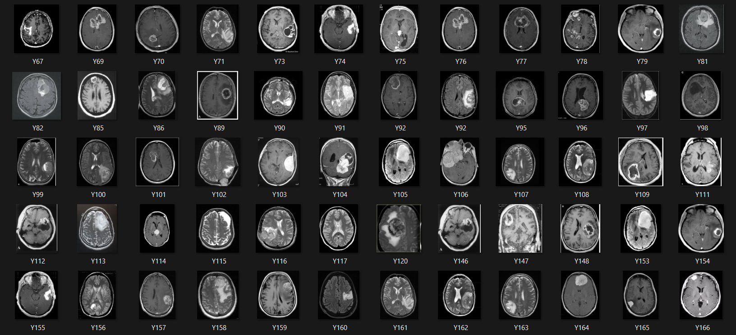
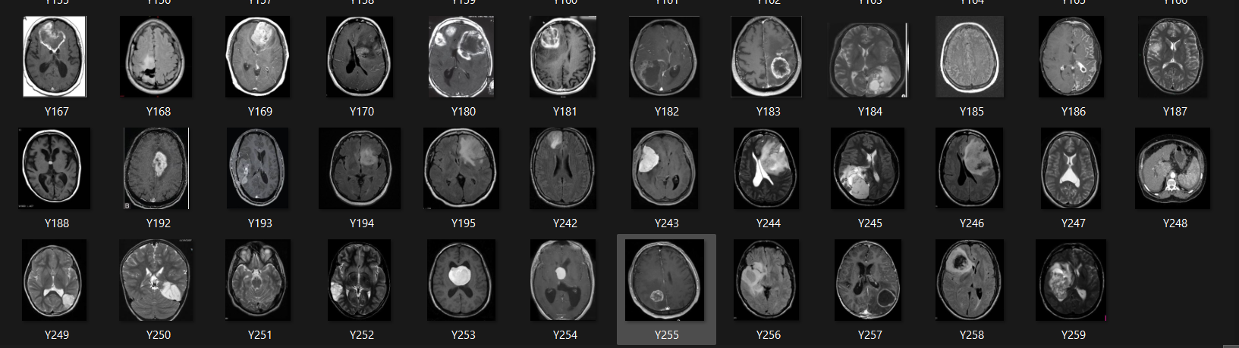

Slide 7
METHODOLOGY
ROI Detection (Tumor Isolation)
Uniform Partitioning
Block Classification and Compact Encoding
Pure ROI Blocks (Green blocks)-Apply Sharpening
Pure RONI Blocks (Blue blocks): Apply Aggressive Lossy Compression
Mixed/Boundary Blocks (Red block): Apply Wavelet-like Enhancement

Slide 8
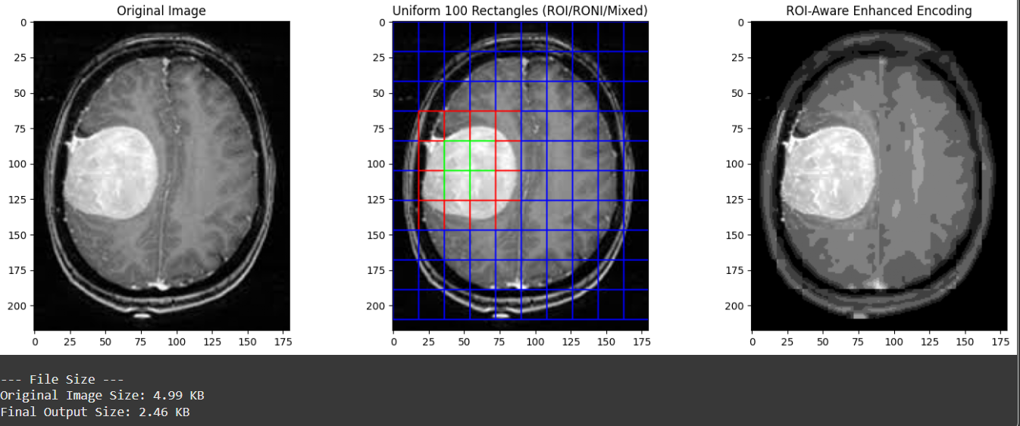
RESULTS

Slide 9
CONCLUSIONS
The project achieves efficient image compression using the ROI-based approach with wavelet transform. The image is divided into rectangular blocks — Pure ROI blocks are enhanced, Pure Non-ROI blocks are blurred, and Mixed blocks are processed using inverse wavelet transform for ROI parts and wavelet transform for Non-ROI parts — ensuring high quality in important regions with effective compression overall.

Slide 10
NEXT SET OF WORK
Optimize Quadtree: adaptive splitting till ROI purity/min size.
Segmentation-Guided Partitioning: use ROI boxes + grid for rest.
Hybrid Evaluation: compare both methods (mixed blocks, time, quality).
Adaptive Threshold: tune based on scene complexity.
Implementation Plan: prototype → integrate → evaluate.

Slide 11
REFERENCES
Ungureanu, V.-I., Negirla, P., & Korodi, A. (2024). *Image-compression techniques: Classical and “region-of-interest-based” approaches presented in recent papers*. *Sensors, 24*(3), 791. [https://doi.org/10.3390/s24030791](https://doi.org/10.3390/s24030791)
Kafashan, M., Hosseini, H., Beygiharchegani, S., Pad, P., & Marvasti, F. (2010, October). New rectangular partitioning methods for lossless binary image compression. In 2010 IEEE 10th International Conference on Signal Processing (ICSP). IEEE. https://doi.org/10.1109/ICOSP.2010.5655736
Bairagi, V., & Sapkal, A. M. (2013). ROI-based DICOM image compression for telemedicine. Indian Academy of Sciences, 38(1), 123–131. https://www.ias.ac.in/public/Volumes/sadh/038/01/0123-0131.pdf
Dataset-https://www.kaggle.com/navoneel/brain-mri-images-for-brain-tumor-detection
Kiran, R., & Kamargaonkar, C. (2016, March). Region based medical image compression using block-based PCA. In 2016 International Conference on Computation of Power, Energy, Information and Communication (ICCPEIC). IEEE. https://doi.org/10.1109/ICCPEIC.2016.7557289

